Slide 2


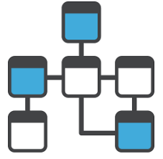





Data Extract using BI Publisher
Define Parameters (SQL Data Model) for Extract (i.e. Changes Only, Business Unit)
Fusion Cloud
1
Inbound / Import
Specify Attributes to be Extracted leveraging Delivered Extract Templates
ERP Tables
2
CSV
XML
3
Select Output Format and Delivery Type
BI Publisher
Outbound / Export
5
4
Define Delivery Schedule
Export Data File and
View Log

Slide 3



Data Extract using BI Publisher
Fusion Cloud
Inbound / Import
ODI / ODI-CS
ERP Tables
CSV
XML
Extract
ODS
UCM
BI Publisher
Export from ERP
Fusion: Create BI Report
ODI /ODI-CS : Run BI Report
ODI /ODI-CS : Download Files from UCM
ODI /ODI-CS : Unzip, Decrypt, Transform
BI
Outbound / Export

Slide 4
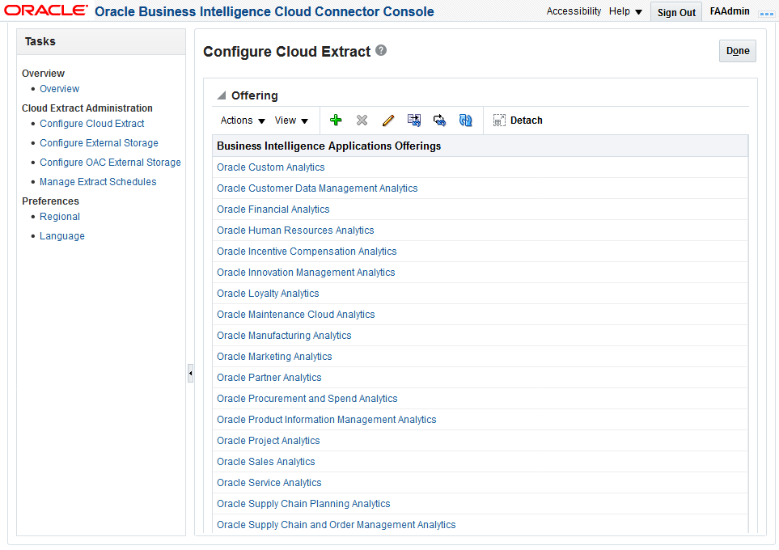
Data Extract using BI Cloud Connector (BICC)
Fusion Cloud
ERP Tables
CSV
BI Cloud Connector Console
Configure Cloud Extract
Configure Target Storage
Manage Extract Schedule
BI View Objects
UCM
Cloud Storage
BI Cloud Connector
Outbound / Export

Slide 5
Data Extract using BI Cloud Connector (BICC)
Fusion Cloud
ODI / ODI-CS
ERP Tables
CSV
BI View Objects
Extract
ODS
UCM
Cloud Storage
BI Cloud Connector
Extract from Fusion App
Fusion App: Configure BICC Extract
ODI /ODI-CS: Run Extract (REST)
ODI /ODI-CS : Download Files from UCM
ODI /ODI-CS : Unzip, Decrypt, Transform
BI
Outbound / Export

Slide 6
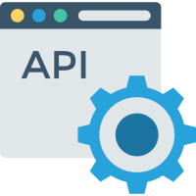
Data Extract using Web Services (SOAP/REST)
Fusion Cloud
ICS or 3rd Party Middleware
ERP Tables
XML
ODS
SOAP
&
REST
APIs
BI

Slide 7
Summary / Comparison
 | Use Cases | Benefits | Challenges | Payload | Source System | Included with SaaS
1. BI Publisher | Bulk Extract Scheduled Extracts No OTBI or BI View Object available Moderate Volumes | Highly Configurable (you write your own SQL) Scheduling Available | Not intended for huge extracts Limit on extract record or size Production Performance Not real time Does NOT manage Incrementals | Multiple formats (CSV, XML, XLS, etc.) | Production Direct Tables | Yes
2. BICC | Bulk Extract High Volumes BI View Objects Exist | Pre-Built / Easy to Configure High Volumes Scheduling Available Manages Incrementals | (Small) Gaps in Content Some transformation nuances | CSV | Production BI View Objects | Yes
3. Web Services (SOAP/REST) | Real Time Requests Smaller Payloads | Real Time…Invoke as Needed | Smaller Payloads Currently Being Built (Gaps in Availability) | XML | Production | Yes

Slide 8




Data Extraction using Integration Access Cloud Service (IACS)
Users
Primary Datacenter
Secondary Datacenter
External
Systems
Active Data Guard
Read Only Query
Redo Apply
Secured SQL Net
Production
Secondary
Customer Design
Near Real Time (Seconds)
Fusion Cloud
8

Slide 9
Data Extraction using IACS and Replication (DIPC/GG)
Fusion Cloud
PaaS
On-Prem
DBaaS
Active Data Guard
Cascade Redo Logs
Redo Apply
Secured SQL Net
DIPC / GG
DIPC / GG
replicat
extract
pump
9

Slide 10
Summary / Comparison
 | Use Cases | Benefits | Challenges | Payload | Source System | Included w/ SaaS
1. BI Publisher | Bulk Extract Scheduled Extracts No OTBI or BI View Object available Moderate Volumes | Highly Configurable (you write your own SQL) Scheduling Available | Not intended for huge extracts Limit on extract record or size Production Performance Not real time Does NOT manage incrementals | Multiple Gormats (CSV, XML, XLS, etc.) | Production Direct Tables | Yes
2. BICC | Bulk Extract High Volumes BI View Objects Exist | Pre-Built / Easy to Configure High Volumes Scheduling Available Manages Incrementals | (Small) Gaps in Content Some transformation nuances | CSV | Production BI View Objects | Yes
3. Web Services (SOAP/REST) | Real Time Requests Smaller Payloads | Real Time…Invoke as Needed | Smaller Payloads Currently Being Built (Gaps in Availability) | XML | Production | Yes
4. IACS | Need Unrestricted (SQL) Access to Secondary Site to Near Real Time Data | Customer chooses tooling / pattern / Scheduling | Additional Cost / Service Oracle Does Not Publish Data Model Changes | SQL*Net Configurable | Secondary Direct Table Access | Additional
5. IACS plus Golden Gate | Need Automated (Near) Real Time Data Capture for Downstream Systems Need to Setup a Near Replication of SaaS DB Externally | Near Real Time External Replication Provides Ultimate Flexibility | Additional Cost / Service Oracle Does Not Publish Data Model Changes | Multiple Formats | Secondary Pushes / Extracts to External Data Model | Additional

